Slide 1
AE/DE/ES/MM/POM ZG523-Merged PROJECT MANAGEMENT
M K Hamirwasia

Slide 2
MONITORING PROJECT PROGRESS
Ch. 13, T1

Slide 3
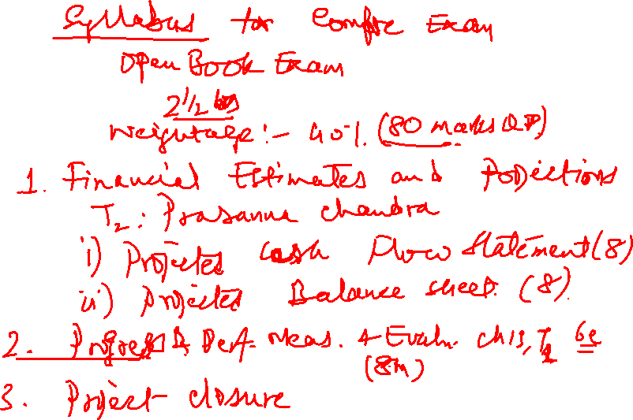
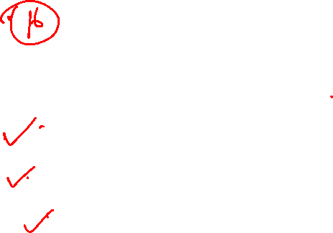
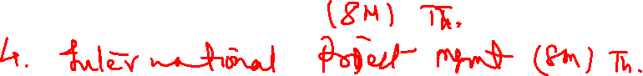

Slide 4
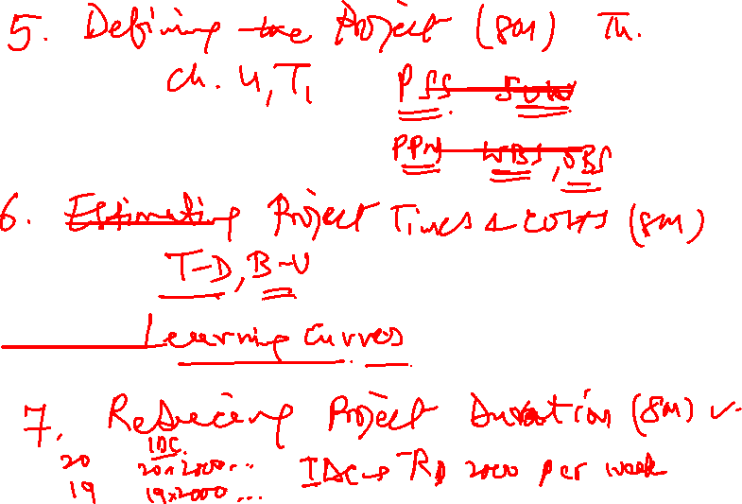
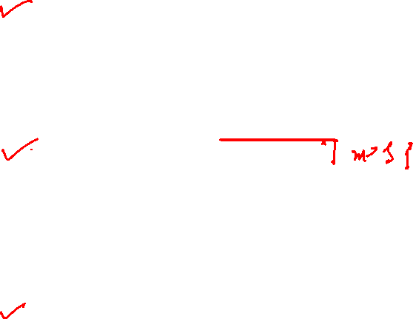

Slide 5
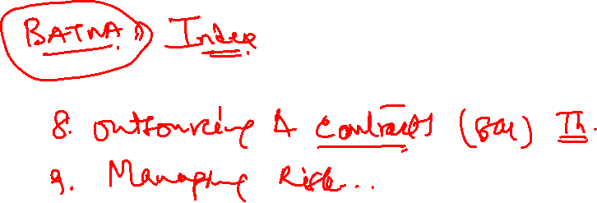
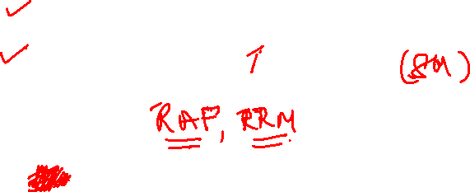

Slide 6
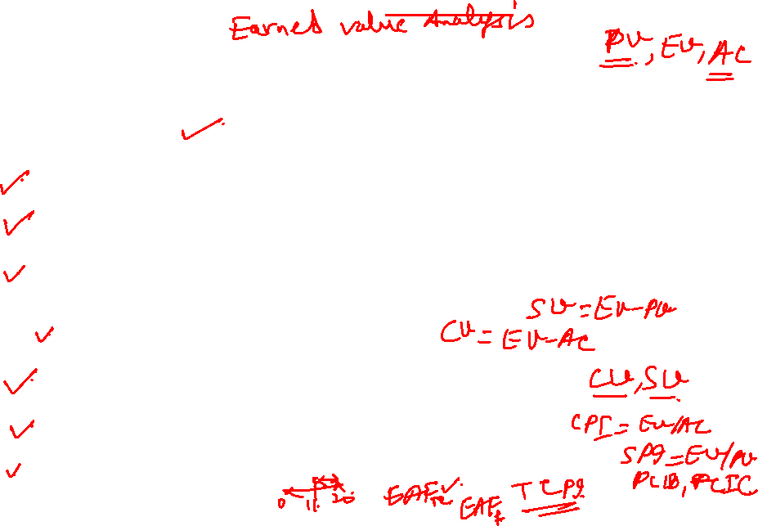
Topics to be Covered
PROJECT MONITORING INFORMATION SYSTEM
THE PROJECT CONTROL PROCESS
MONITORING SCHEDULE PERFORMANCE
MONITORING COST PERFORMANCE
EARNED VALUE COST/SCHEDULE SYSTEM
METHODS OF VARIANCE ANALYSIS
DEVELOPING A STATUS REPORT
INDICES TO MONITOR PROGRESS
FORECASTING FINAL PROJECT COST

Slide 7
PROJECT MONITORING INFORMATION SYSTEM
Effective project management requires planning, measuring, evaluating, forecasting and controlling all aspects of a project: quality and quantity of work, costs, and schedules.
Large projects need some form of formal control.
Control holds people responsible, prevents small problems from growing into large ones, and keeps focus.
Thus, for effective control, the PM needs a single information system to collect data and report progress on cost, schedule and specifications.

Slide 8

PROJECT MONITORING INFORMATION SYSTEM
A project monitoring information system involves:
Determining what data to collect;
How, when and who will collect the data;
Analysis of the data;
And reporting current progress.

Slide 9
PROJECT MONITORING INFORMATION SYSTEM
What data are collected?
Key data collected are:
Actual activity duration times,
Actual costs,
Resource usage and rates.
These are compared against planned schedules, budgets and resources.

Slide 10
PROJECT MONITORING INFORMATION SYSTEM
You should have information to answer questions such as:
What is the current status of the project in terms of schedule and cost?
• How much will it cost to complete the project?
• When will the project be completed?
• Are there potential problems that need to be addressed now?
• What, who, and where are the causes for cost or schedule overruns?
• What did we get for the rupees spent?
• If there is a cost overrun midway in the project, can we forecast the overrun at completion?

Slide 11
PROJECT MONITORING INFORMATION SYSTEM
Collecting Data and Analysis
Establish who, when and how the data will be assembled.
Will the data be collected by the :
Project Manager, or
Project Team, or
Contractor, or
Independent cost engineers?
What should be the reporting period:
One day, one week, or one month?
From where will the data be derived:
Machine hours, labour hours, cash flow, or materials in place?

Slide 12
PROJECT MONITORING INFORMATION SYSTEM
Reports and Reporting
A common topic format for progress reports is:
• Progress since last report
• Current status of project
1. Schedule
2. Cost
3. Scope
• Cumulative trends
• Problems and issues since last report
1. Actions and resolution of earlier problems
2. New variances and problems identified
• Corrective action planned

Slide 13
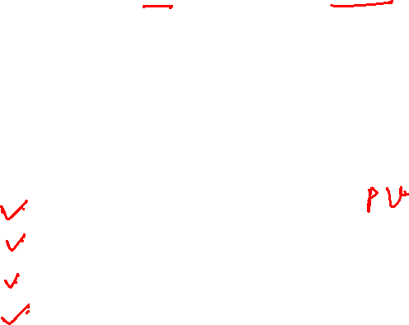
THE PROJECT CONTROL PROCESS
Control is the process of comparing actual performance against plan to identify deviations, evaluate possible alternative courses of actions, and take appropriate corrective action.
The project control steps for measuring and evaluating project performance are:
1. Setting a baseline plan.
2. Measuring progress and performance.
3. Comparing plan against actual.
4. Taking action.

Slide 14
THE PROJECT CONTROL PROCESS
Step 1: Setting a Baseline Plan
The baseline plan provides us with the elements for measuring performance.
The baseline is derived from the cost and duration information found in the work breakdown structure (WBS) database and time-sequence data from the network and resource scheduling decisions.
From the WBS the project resource schedule is used to time-phase all work, resources, and budgets into a baseline plan.

Slide 15

THE PROJECT CONTROL PROCESS
Step 2: Measuring Progress and Performance
Measurement of time performance is relatively easy and obvious. That is, is the critical path early, on schedule, or late; is the slack of near-critical paths decreasing to cause new critical activities?
Measuring performance against budget (e.g., money, units in place, labor hours) is more difficult and is not simply a case of comparing actual versus budget.
Earned value is necessary to provide a realistic estimate of performance against a time-phased budget.
Earned value (EV) is defined as the budgeted cost of the work performed.

Slide 16
THE PROJECT CONTROL PROCESS
Step 3: Comparing Plan against Actual
Because plans seldom materialize as expected, it becomes imperative to measure deviations from plan to determine if action is necessary.
Periodic monitoring and measuring the status of the project allow for comparisons of actual versus expected
plans.
Usually status reports should take place every one to four weeks to be useful and allow for proactive correction.

Slide 17
THE PROJECT CONTROL PROCESS
Step 4: Taking Action
If deviations from plans are significant, corrective action will be needed to bring the project back in line with the original or revised plan.
In some cases, conditions or scope can change, which, in turn, will require a change in the baseline plan to
recognize new information.

Slide 18
MONITORING SCHEDULE PERFORMANCE
The project network schedule, derived from the WBS /OBS, serves as the baseline to compare against actual performance.
Gantt charts (bar charts) and control charts are the typical tools used for tracking and trending schedule performance.
Their easy-to-understand visual formats make them favorite tools for communicating project schedule status—especially to top management, who do not usually have time for details.
Adding actual and revised time estimates to the Gantt chart gives a quick overview of project status on the report date.

Slide 19
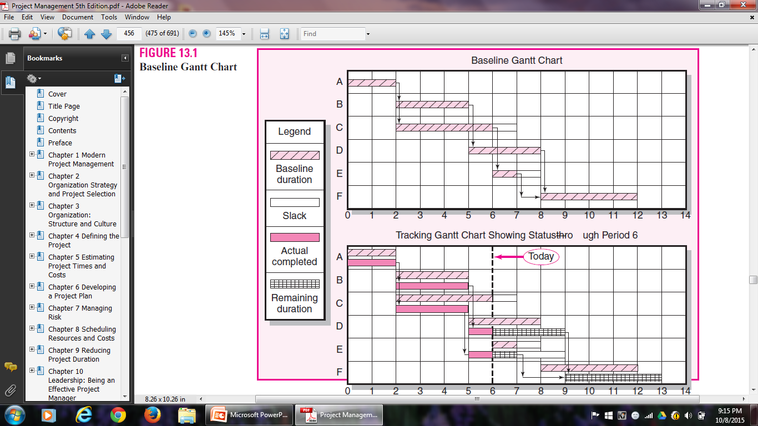

Gantt Chart
Gantt Chart

Slide 20
Control Chart
The Control Chart is another tool used to monitor past project schedule performance and current performance and to estimate future schedule trends.
The chart is used to plot the difference between the scheduled time on the critical path at the report date with the actual point on the critical path.
Control chart trends are very useful for giving warning of potential problems so appropriate action can be
taken if necessary.
Control charts are also frequently used to monitor progress toward milestones, which mark events and as such have zero duration.

Slide 21
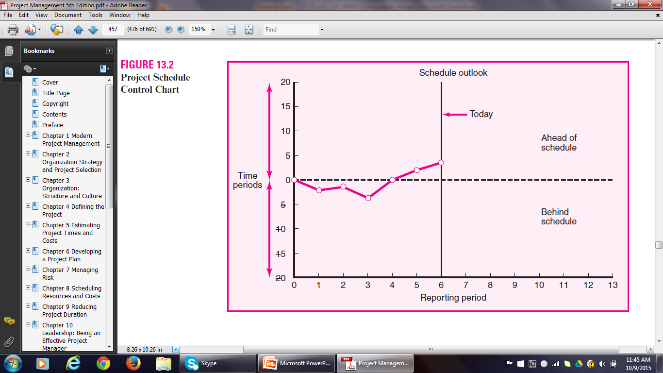

Control Chart

Slide 22
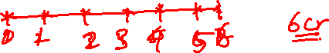
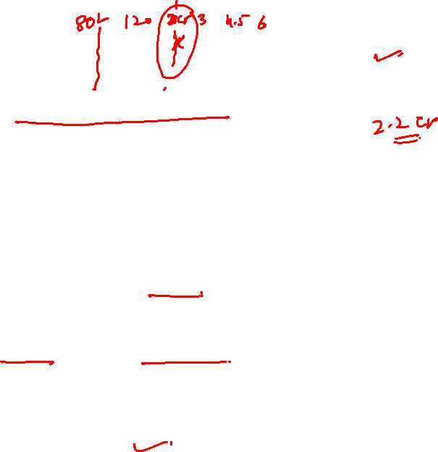
MONITORING COST PERFORMACE
EARNED VALUE COST/SCHEDULE SYSTEM
The earned value system starts with the time-phased costs that provide the project budget baseline, which is called the planned budgeted value of the work scheduled (PV).
Given this time-phased baseline, comparisons are made with actual and planned schedule and costs using earned value.
At any point in time, a status report can be developed for the project.

Slide 23
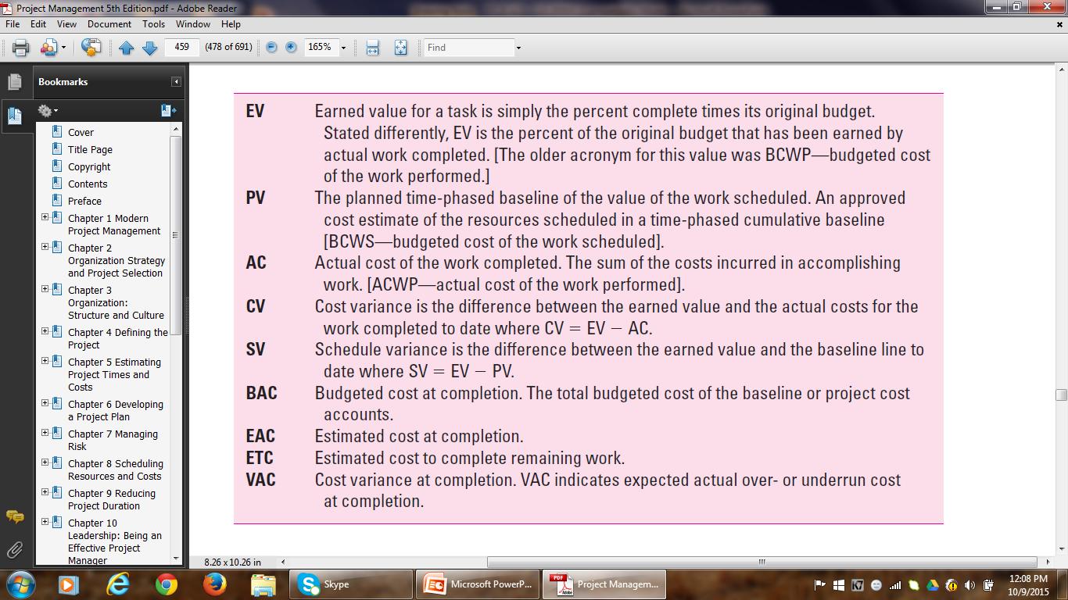
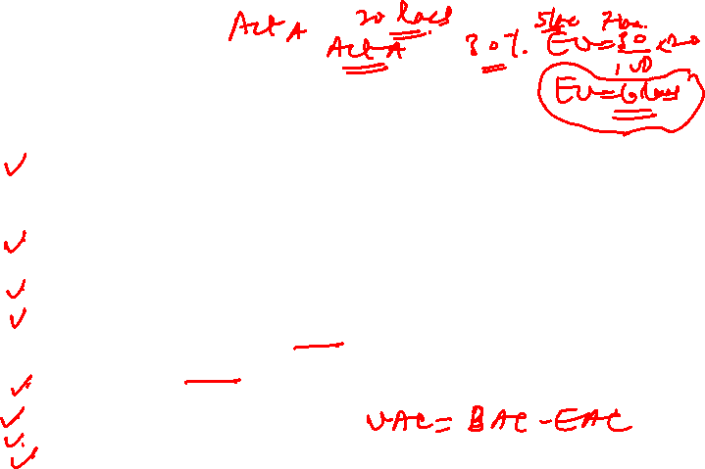
Glossary of Terms

Slide 24
EARNED VALUE COST/SCHEDULE SYSTEM
The major reasons for creating a baseline are to monitor and report progress and to estimate cash flow.
Therefore, it is crucial to integrate the baseline with the performance measurement system.
Costs are placed (time-phased) in the baseline
exactly as managers expect them to be “earned.”

Slide 25
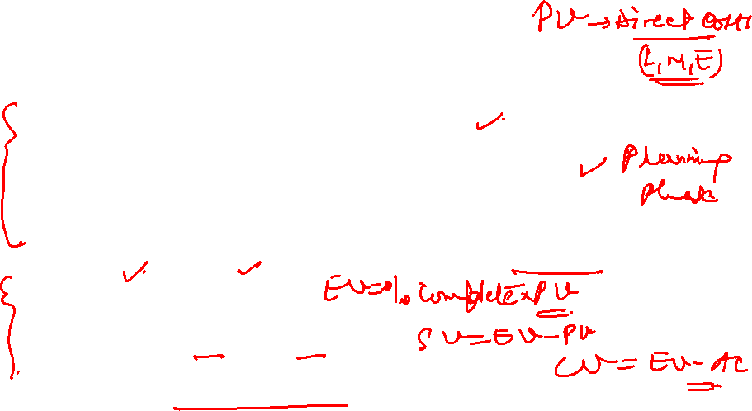
EARNED VALUE COST/SCHEDULE SYSTEM
Steps to integrate the cost/schedule system:
Define the work using a WBS.
2. Prepare the project network schedule.
3. Develop a time-phase budget using work packages included in an activity. Get PV.
4. Get AC and EV.
5. Compute SV and CV.
Prepare hierarchical status reports.

Slide 26
Development of Project Baselines
Purposes of a Baseline (PV)
An anchor point for measuring performance
A planned cost and expected schedule against which actual cost and schedule are measured.
A basis for cash flows and awarding progress payments.
A summation of time-phased budgets (cost accounts as summed work packages) along a project timeline.
What Costs Are Included in Baselines?
Labour, equipment, materials, project direct overhead costs (DOC e.g. drinking water for project staff)

Slide 27
Development of Project Baselines
Rules for Placing Costs in Baselines
Costs are placed (time-phased) exactly as they are expected to be “earned” in order to track them to their point of origin.
Percent Complete Rule
Costs are periodically assigned to a baseline as units of work are completed over the duration of a work package.

Slide 28
Methods of Variance Analysis
Comparing Earned Value
With the expected schedule value.
With the actual costs.
Assessing Status of a Project
Required data elements
Budgeted cost of the work scheduled (PV)
Budgeted cost of the work completed (EV)
Actual cost of the work completed (AC)
Calculate SV and CV
A positive variance indicates a desirable condition, while a negative variance suggests problems or changes that have taken place.

Slide 29
Methods of Variance Analysis
Cost variance tells us if the work accomplished costs more or less than was planned at any point over the life of the project.
Schedule variance presents an overall assessment of all work packages in the project scheduled to date.
Schedule variance measures progress in rupees rather
than time units.
The only accurate method for determining the true time progress of the project is to compare the project network
schedule against the actual network schedule to measure if the project is on time.

Slide 30
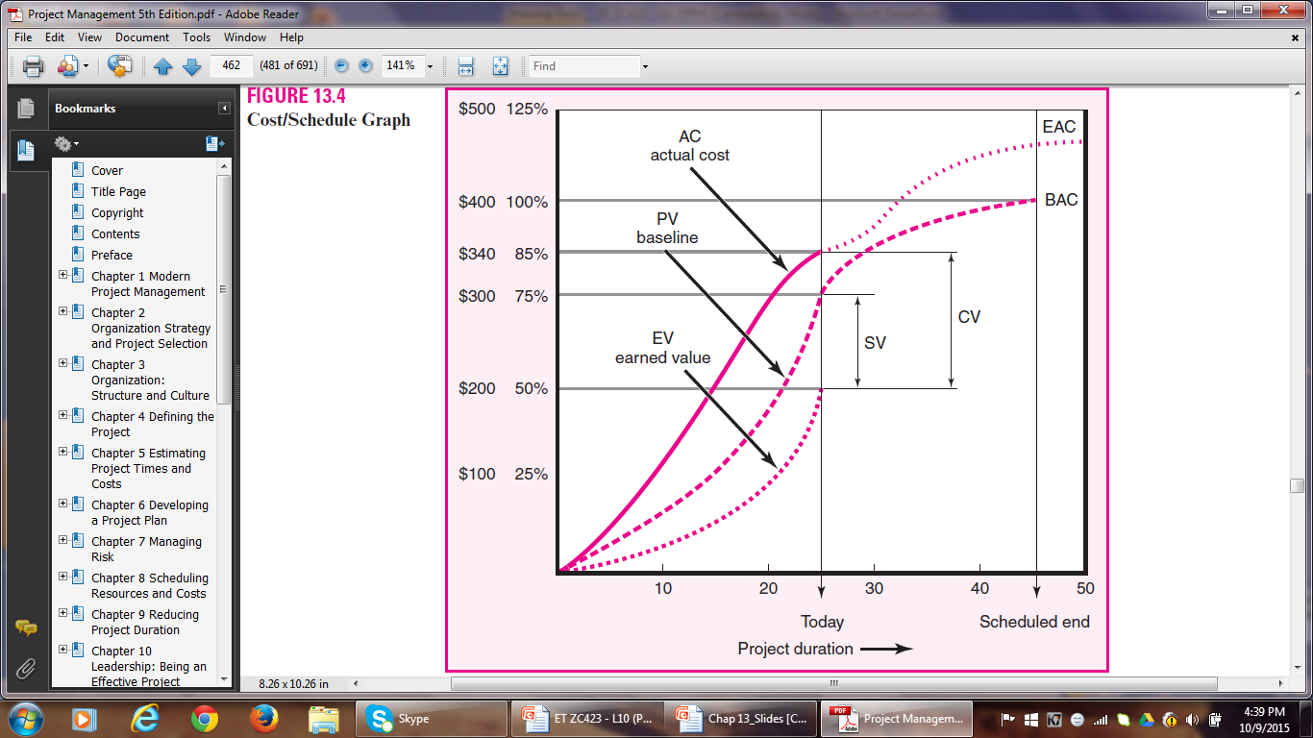
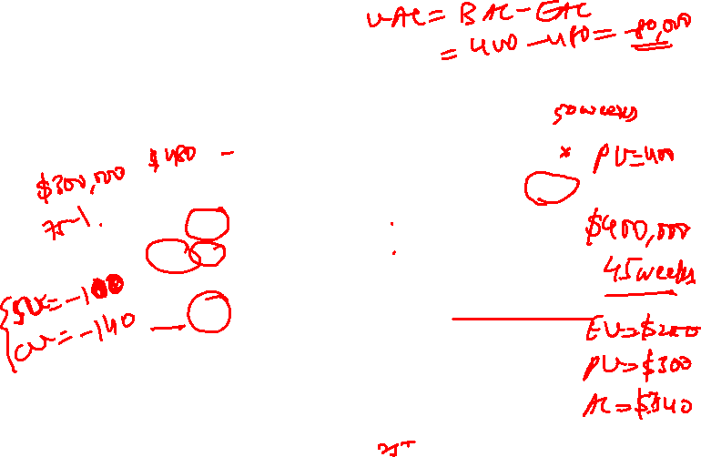
Methods of Variance Analysis
Cost / Schedule Graph

Slide 31
DEVELOPING A STATUS REPORT
A Hypothetical Example
Information:
Figure 13.6 (Work Breakdown Structure with Cost Accounts) depicts a simple work breakdown structure (WBS/OBS) for the Digital Camera example. There are six deliverables (Design Specifications, Shell & Power, Memory/Software, Zoom System, Assemble, and Test), and five responsible departments (Design, Shell, Storage, Zoom, and Assembly).
The total for all the cost accounts (CA) is $320,000, which represents the total project cost.
Figure 13.7, derived from the WBS, presents a planning Gantt chart for the Digital Camera project. The planned project duration is 11 time units.

Slide 32
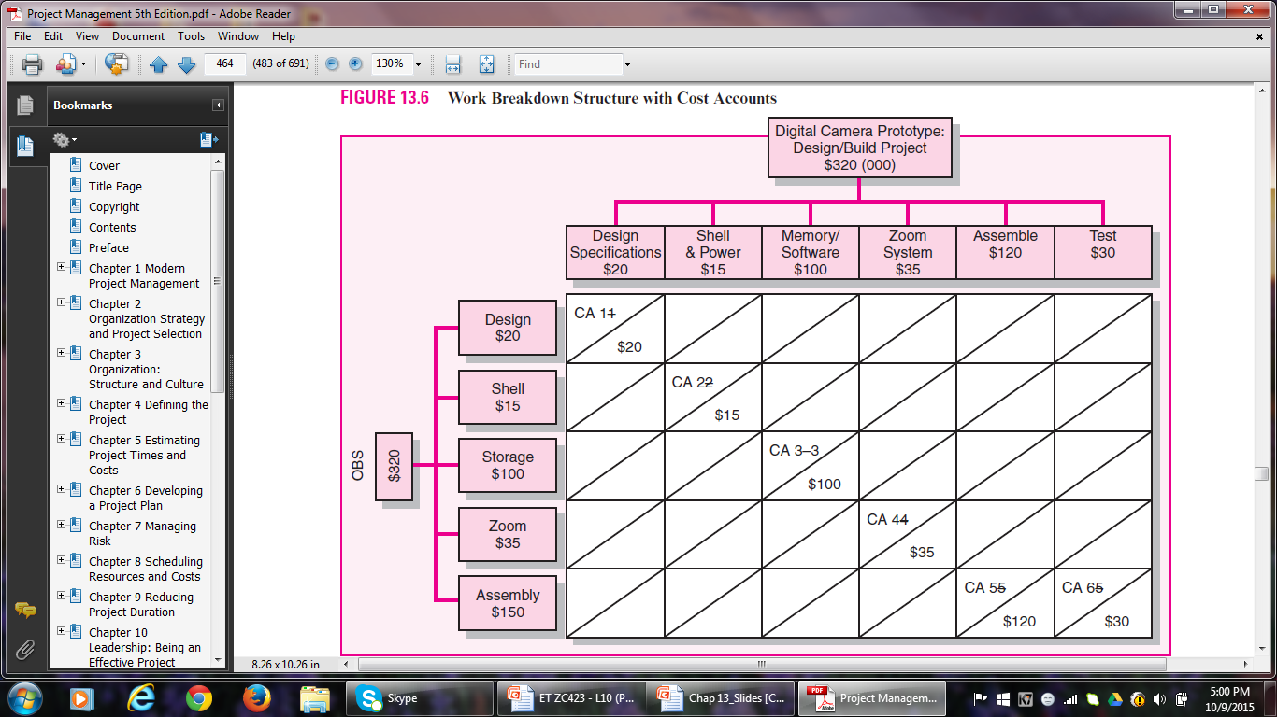
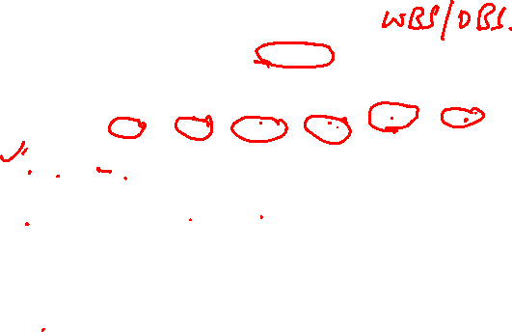
Baseline Development

Slide 33
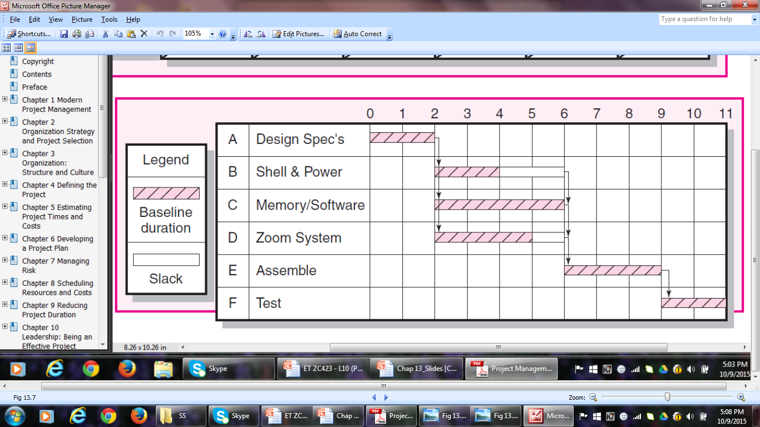

Fig 13.7 Project Baseline Gantt Chart

Slide 34
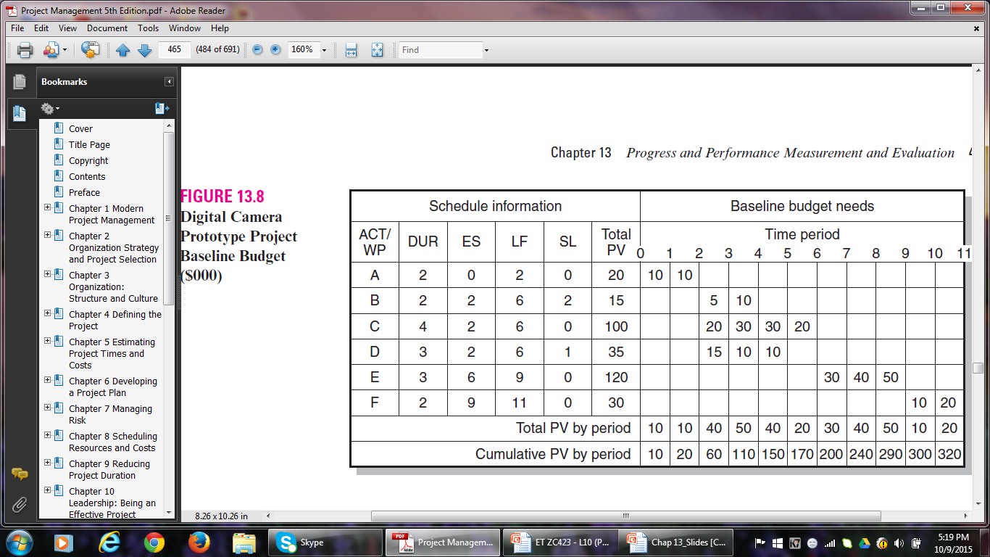
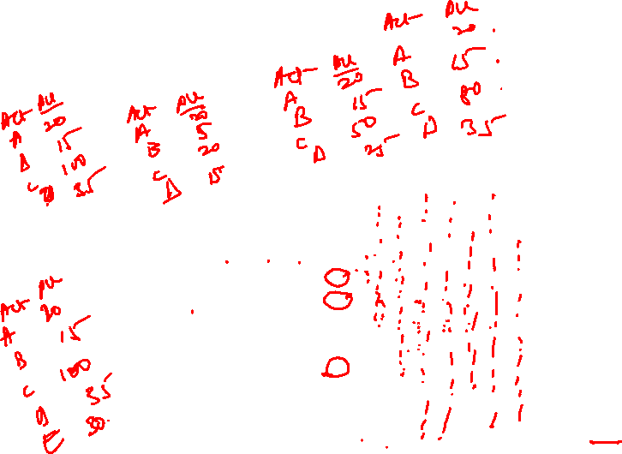
Project Baseline Budget

Slide 35
Development of the Status Report
The status report uses earned value to measure schedule and cost performance.
We will only use the percent complete rule to measure progress.
Each period percent complete and actual cost were gathered for each task from staff in the field.
The schedule and cost variance are computed for each task and the project to date.
Table 13.2 presents the status reports for periods 1 through 7.

Slide 36
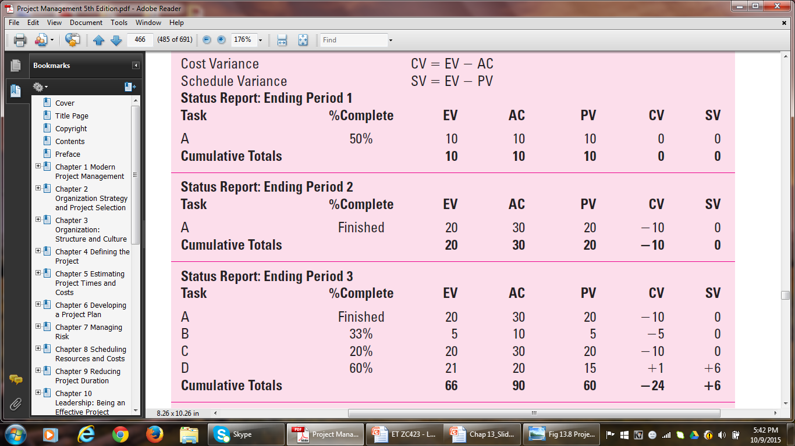
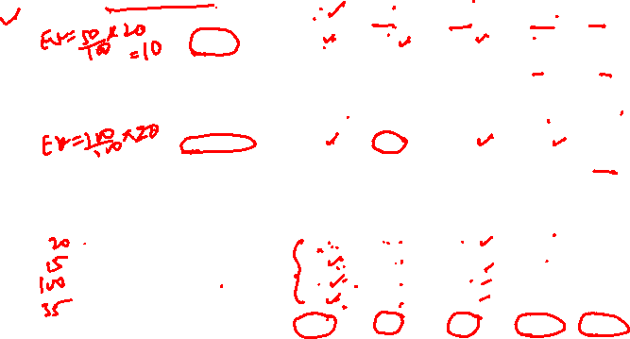
Status Reports Periods 1-7

Slide 37
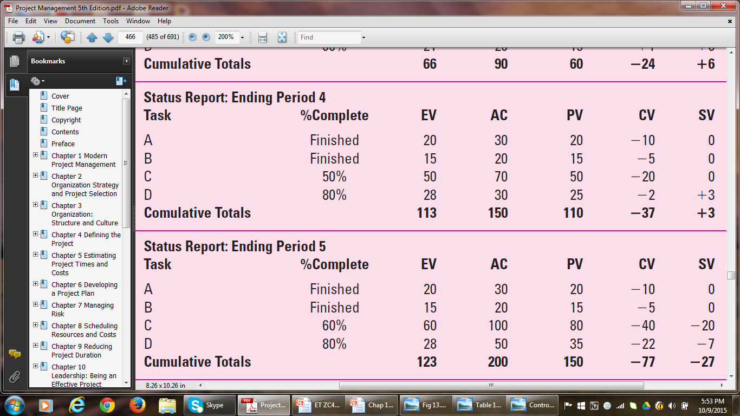
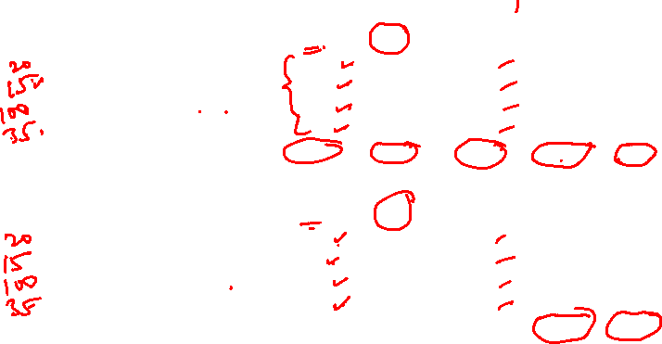
Table 13.2

Slide 38
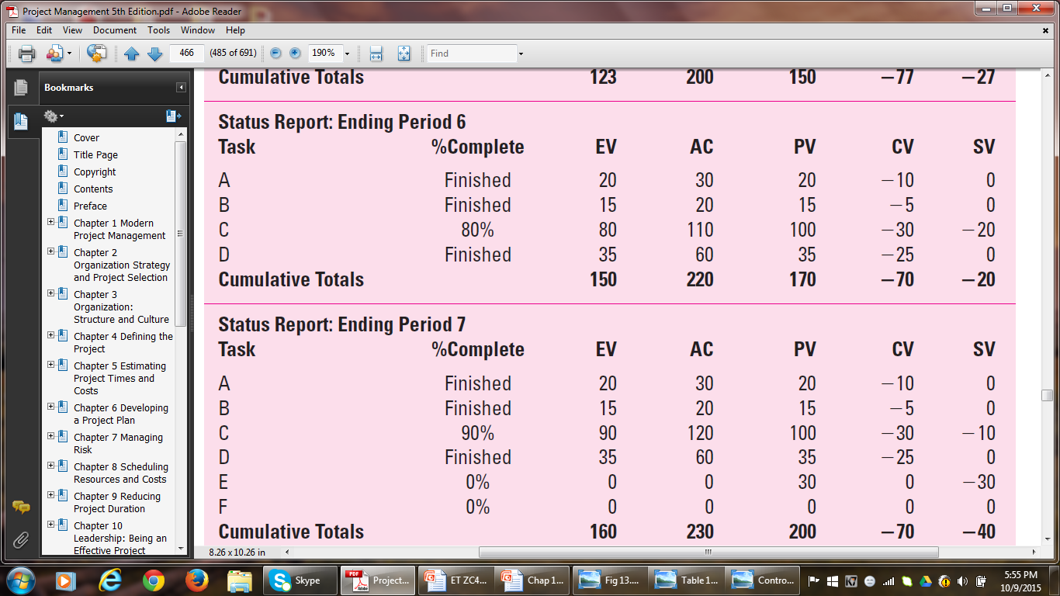

Table 13.2

Slide 39
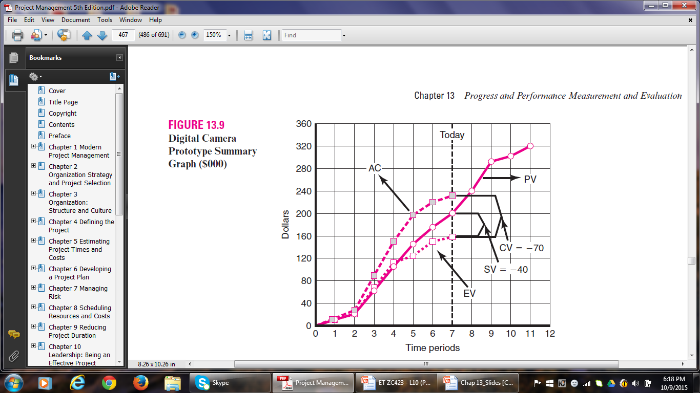
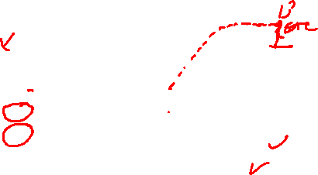
Graph

Slide 40
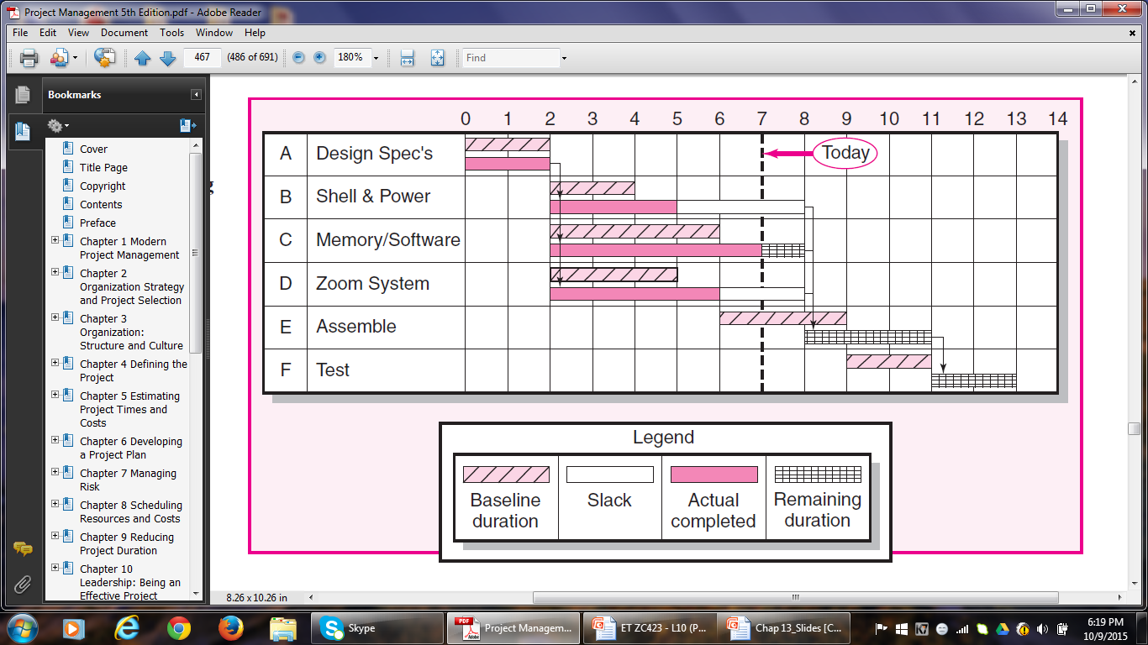
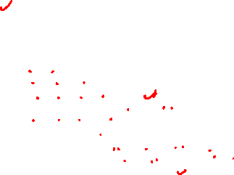
Tracking Gantt Chart

Slide 41

Performance Indices
Cost Performance Index (CPI)
Measures the cost efficiency of work accomplished to date.
CPI = EV/AC
A CPI of .70 indicates that $0.70 worth of work planned to date has been accomplished for every $1.00 actually spent.
CPI is found to be stable from the 20% completion point regardless of contract type, program or service.
Scheduling Performance Index (SPI)
Measures scheduling efficiency
SPI = EV/PV
An SPI of .80 shows that $.80 worth of work has been completed for each $1.00 worth of scheduled work to date.

Slide 42
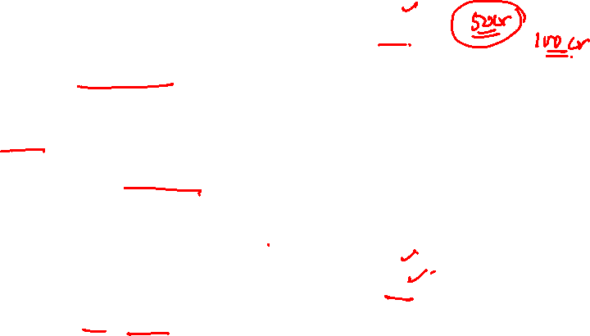
Percent Complete Indices
– Percent Complete index PCIB
PCIB = EV/BAC
This index looks at percent complete in terms of budget amounts.
A PCIB of .50 indicates the work accomplished represents 50 percent of the total budgeted amount (BAC) to date.
– Percent Complete Index PCIC
PCIC = AC/EAC
This index views percent complete in term of actual dollars spent to accomplish the work to date and the actual expected dollars for the completed project (EAC)

Slide 43
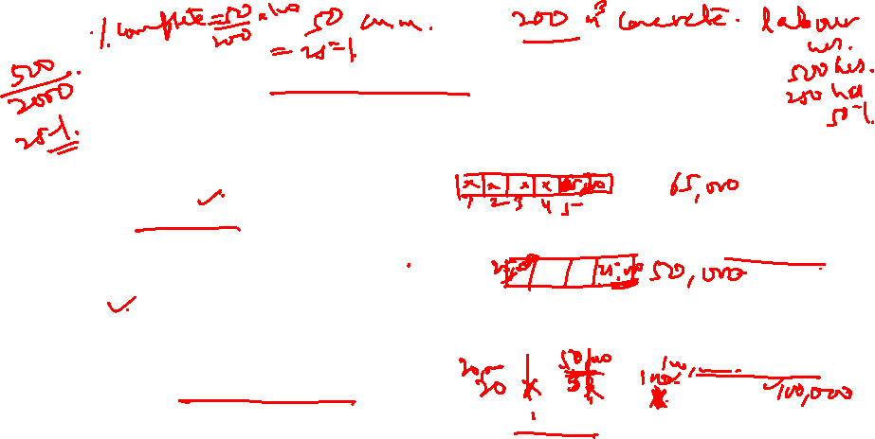
Additional Earned Value Rules
Although the percent complete rule is the most-used method of assigning budgets to baselines and for cost control, there are additional rules that are very useful for reducing the overhead costs of collecting detailed data on percent complete of individual work packages.
0/100 rule – Here 100 percent of the budget is earned when the work package is completed. This is used for WPs having very short durations.
50/50 rule – This rule allows 50% of the value of the WP budget to be earned when it is started and 50% to be earned when the package is completed. This rule is popular for WPs of short duration and small total costs.
Percent complete with weighted monitoring gates – This works well on long-duration activities. Assume a long-duration activity with a total budget of $500. The activity is cut into three sequentially discrete packages with monitoring gates representing 30, 50 and 100 percent of the total budget. The earned amount at each monitoring gate cannot exceed $150, $250, and $500.

Slide 44
FORECASTING FINAL PROJECT COST
Methods used to revise estimates of future project costs:
EAC_{re}
Allows experts in the field to change original baseline durations and costs because new information tells them the original estimates are not accurate.
EAC_{f}
Uses actual costs-to-date plus an efficiency index to project final costs in large projects where the original budget is unreliable.

Slide 45
FORECASTING FINAL PROJECT COST
The equation for calculating revised estimated cost at completion (EAC_{re}) is as follows:
EACre = AC + ETCre
where EACre = revised estimated cost at completion.
AC = cumulative actual cost of work completed to date.
ETCre = revised estimated cost to complete remaining work.

Slide 46
FORECASTING FINAL PROJECT COST
The second method is used for large projects where the original budget is less reliable.
The equation for this forecasting model (EACf) is as follows:
EACf = ETC + AC
ETC = Work remaining ÷ CPI = (BAC – EV) ÷ EV/AC
where EACf = estimated total cost at completion.
ETC = estimated cost to complete remaining work.
AC = cumulative actual cost of work completed to date.
CPI = cumulative cost index to date.
BAC = total budget of the baseline.
EV = cumulative budgeted cost of work completed to date.

Slide 47
FORECASTING FINAL PROJECT COST
The following information is available from our earlier example; the estimated cost at completion (EAC_{f}) is computed as follows:
Total baseline budget (BAC) for the project $320
Cumulative earned value (EV) to date $160
Cumulative actual cost (AC) to date $230
EAC_{f} = (320 – 160) ÷ (160/230) + 230 = 230 + 230
EAC_{f} = 230 + 230 = 460
The final project projected cost forecast is $460,000 versus $320,000 originally planned.

Slide 48
FORECASTING FINAL PROJECT COST
Another popular index is the To Complete Performance Index (TCPI), which is useful as a supplement to the estimate at complete (EAC_{f}) computation.
This ratio measures the amount of value each remaining dollar in the budget must earn to stay within the budget.
The index is computed for the Digital Camera project at
the end of period 7.
TCPI = (BAC – EV) ÷ (BAC – AC) = 320 – 160 ÷ 320 – 230
= 160 ÷ 90 = 1.78
The index of 1.78 indicates that each remaining dollar in the budget must earn $1.78 in value.

Slide 49
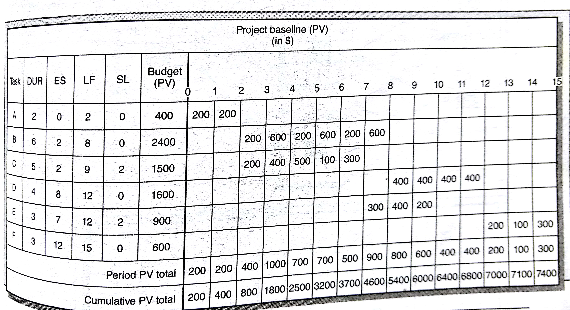
Q.3. Page 698-699 T1

Slide 50
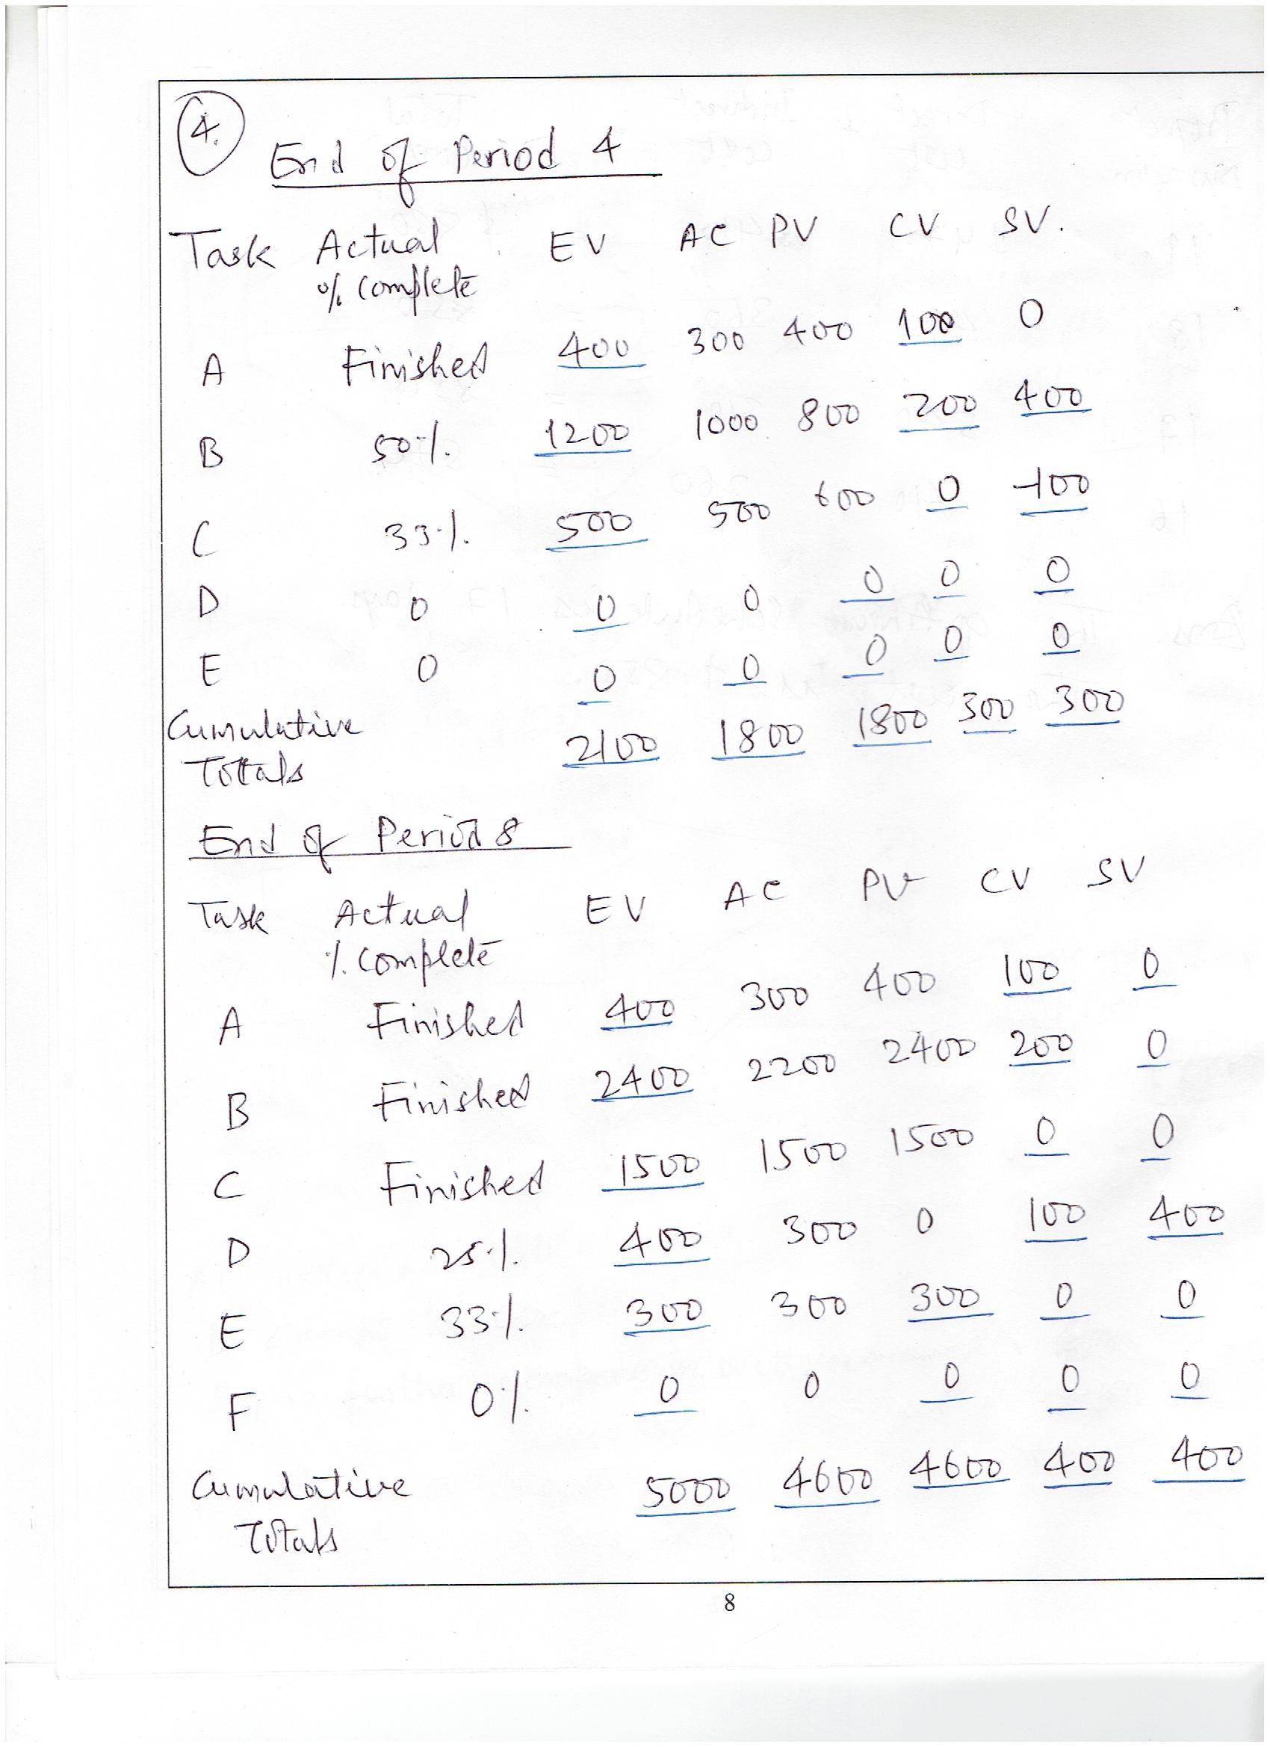
Exercise Page 698 T1
Solution Q.3.

Slide 51
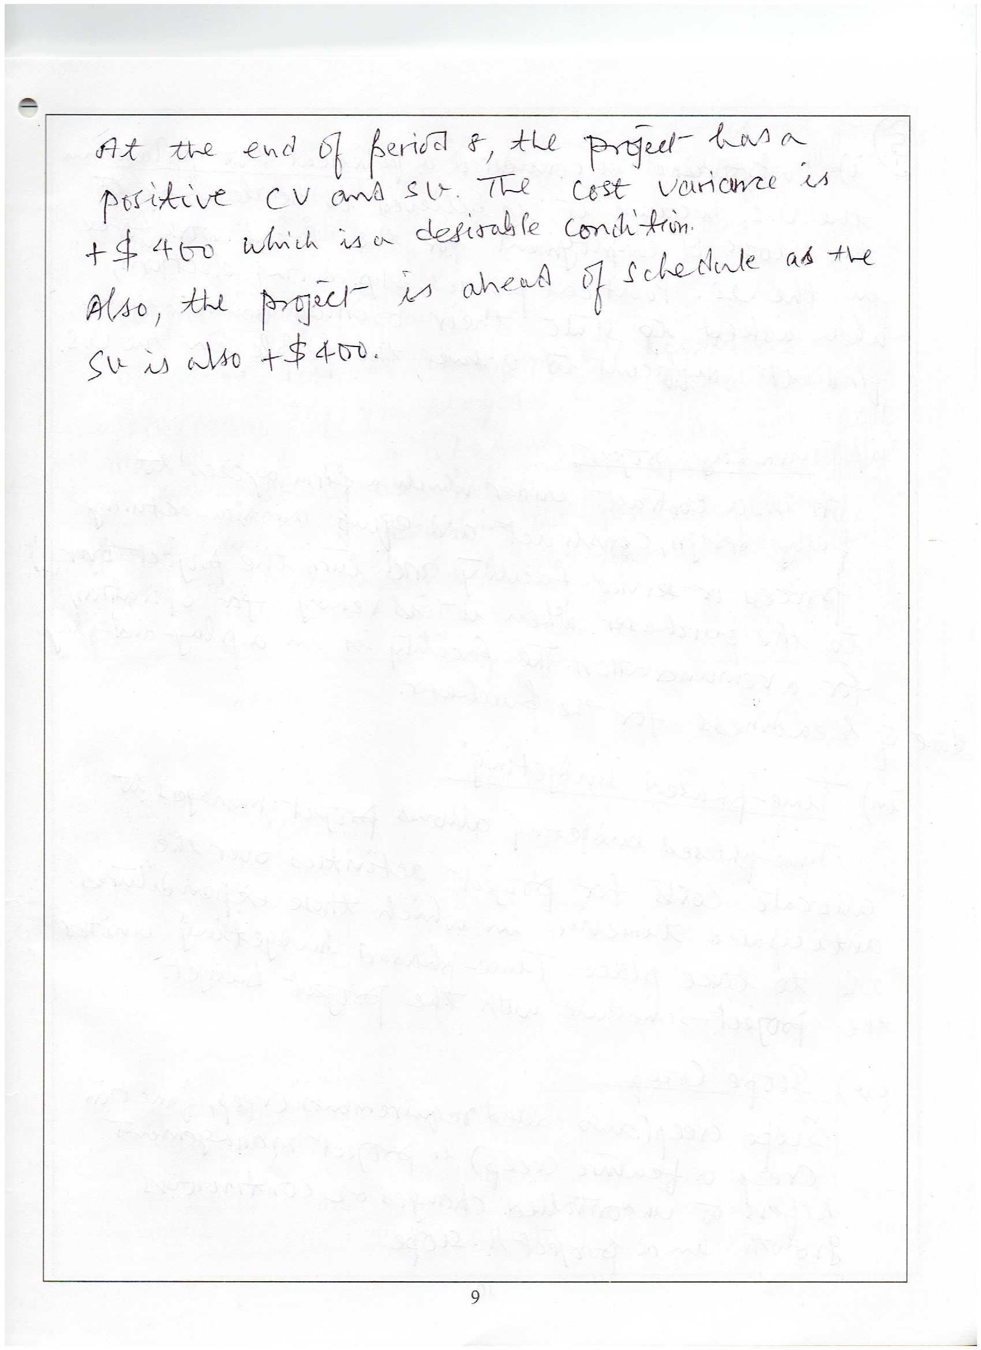
Exercise Page 698 T1
Solution Q.3.

Slide 52
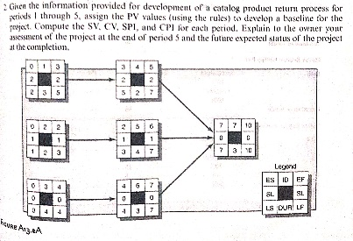

Slide 53
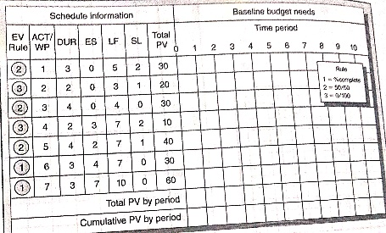


Slide 54
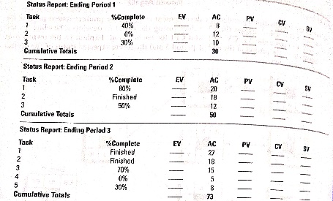

Slide 55

Assume that you are the project manager on a project that has Rs. 50,00,000 project work effort. There are two teams that will work for 5 months for a total of 1600 hours. According to the project schedule your team should be done with 40% of the work. As of today, the project is 35% complete while 50% budget has been used.
Determine the CV, SV, CPI, SPI, PCIB, PCIC, ETC, EAC_{f}, TCPI.
PCIB = EV/BAC
PCIC = AC/EAC
ETC = Work Remaining/CPI = (BAC - EV)/(EV/AC)
EAC_{f} = ETC + AC
TCPI = (BAC - EV)/ (BAC - AC)

Slide 56
PROGRESS and PERFORMANCE MEASUREMENT and EVALUATION
Thank You!

